Slide 1
SNAP Participation
and Expenditures
Database Warehouse Project
Group 6 - You, Eli, Lauren, Trey
BUAD 5272

Slide 2
Agenda
Introduction
Dimensional Model Diagrams
ETL Process
SQL Schema
Tableau Analytics
Conclusion

Slide 3
Introduction
Data sourced from the Virginia Local Department of Social Services
SNAP - supplemental nutrition assistance program
Government program provides food purchasing assistance to low and no income households
Data covers 5 years of research
Divisions by county and year, as well as public and non-public assistance
Analysis Question: What is the average participation rate in the SNAP program per household per county in Virginia?
Notes:
State that our research covers 5 years of the data for simplicity and timeliness when running the program

Slide 4
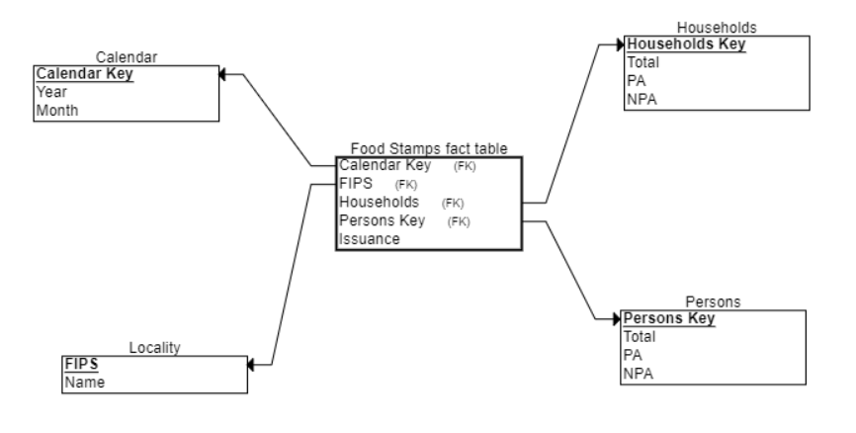
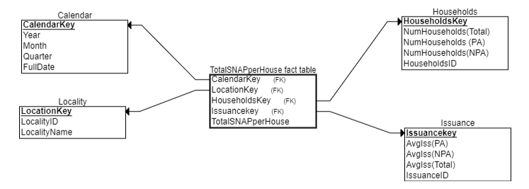
Dimensional Model Diagrams
Initial:
Person dimension
Locality dimension lacking
Issuance as a fact
PA/NPA in numerous spots
Final:
Issuance dimension
Removal of Person dimension
More informative other dimensions

Slide 5
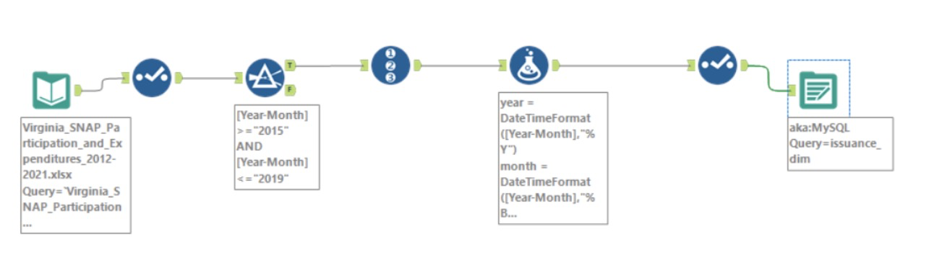
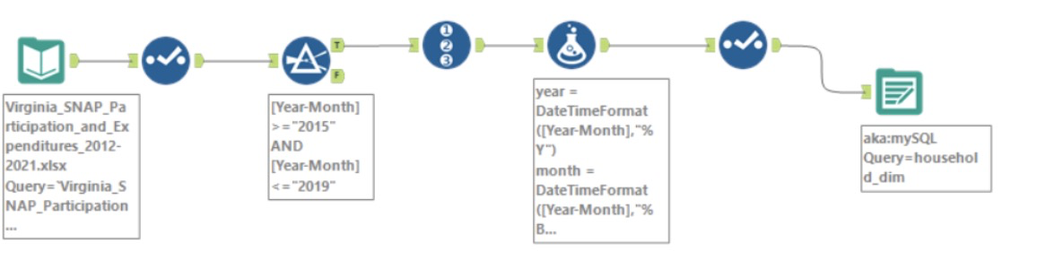
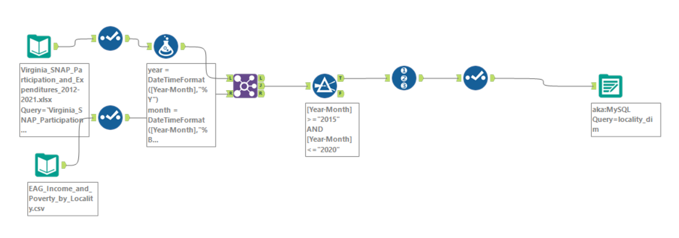
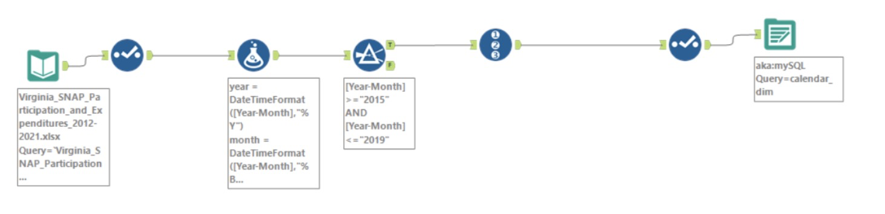
ETL Process - Dimensions
Locality Workflow
Issuance Workflow
Household Workflow
Calendar Workflow

Slide 6
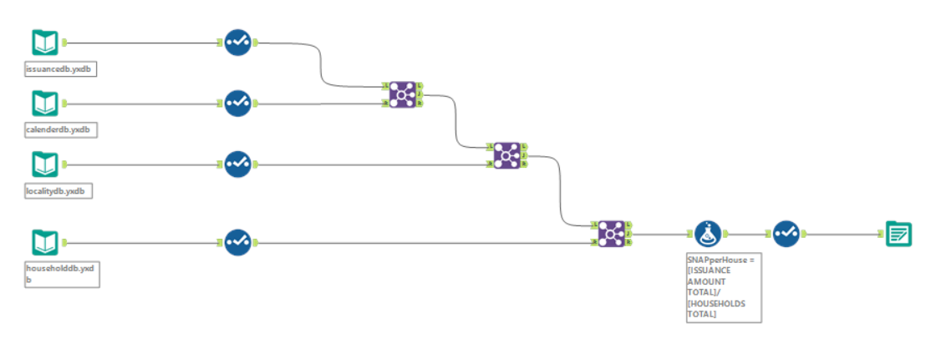
ETL Process - Fact Table Workflow

Slide 7
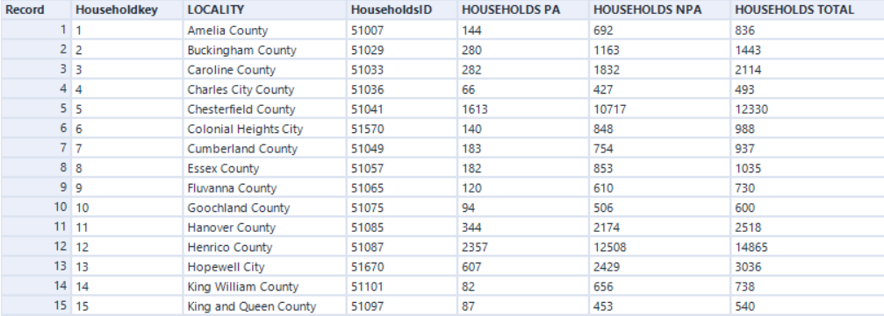
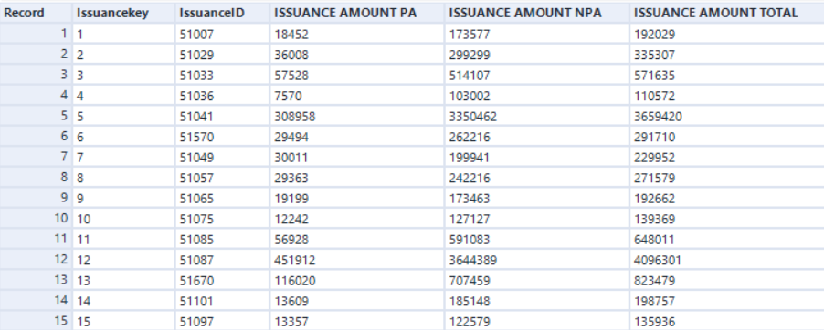
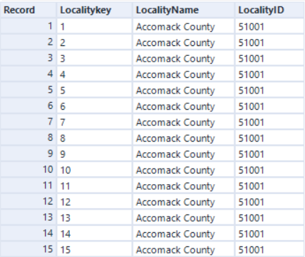
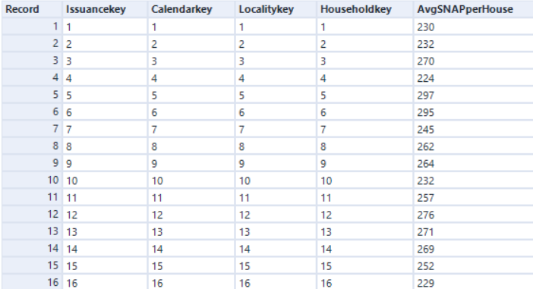
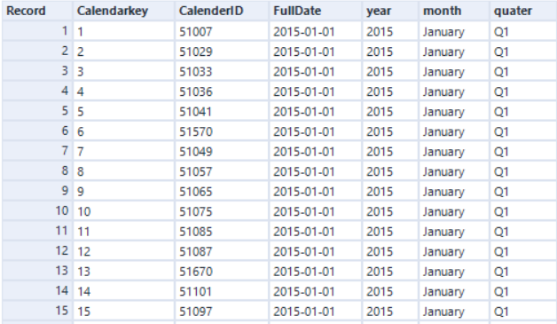
ETL Process - Database Excerpts
Household Database
Issuance Database
Locality Database
TotalSNAPperhouse Fact Table Database
Calendar Database

Slide 8
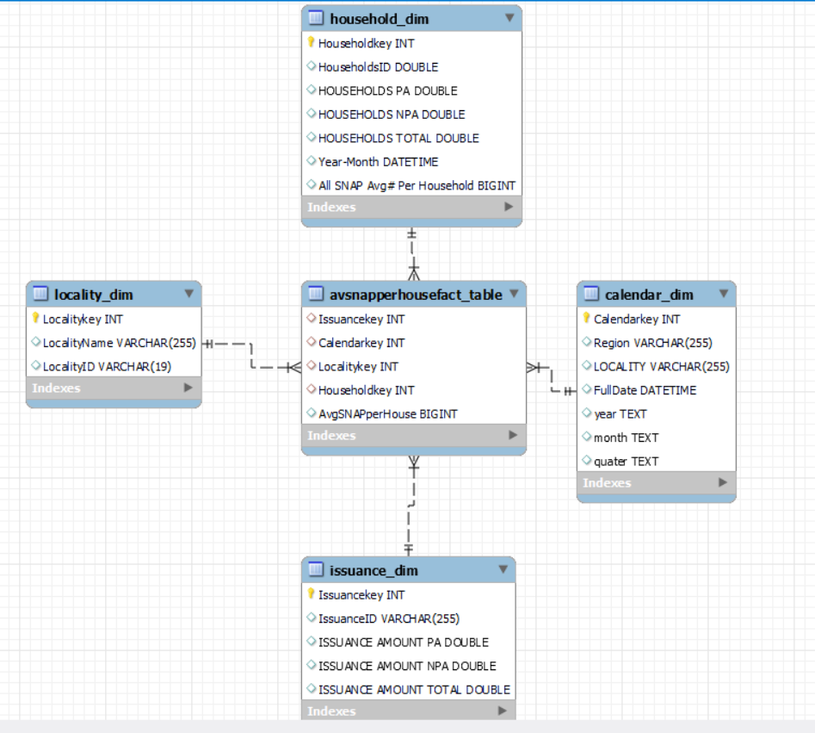
MySQL Schema

Slide 9
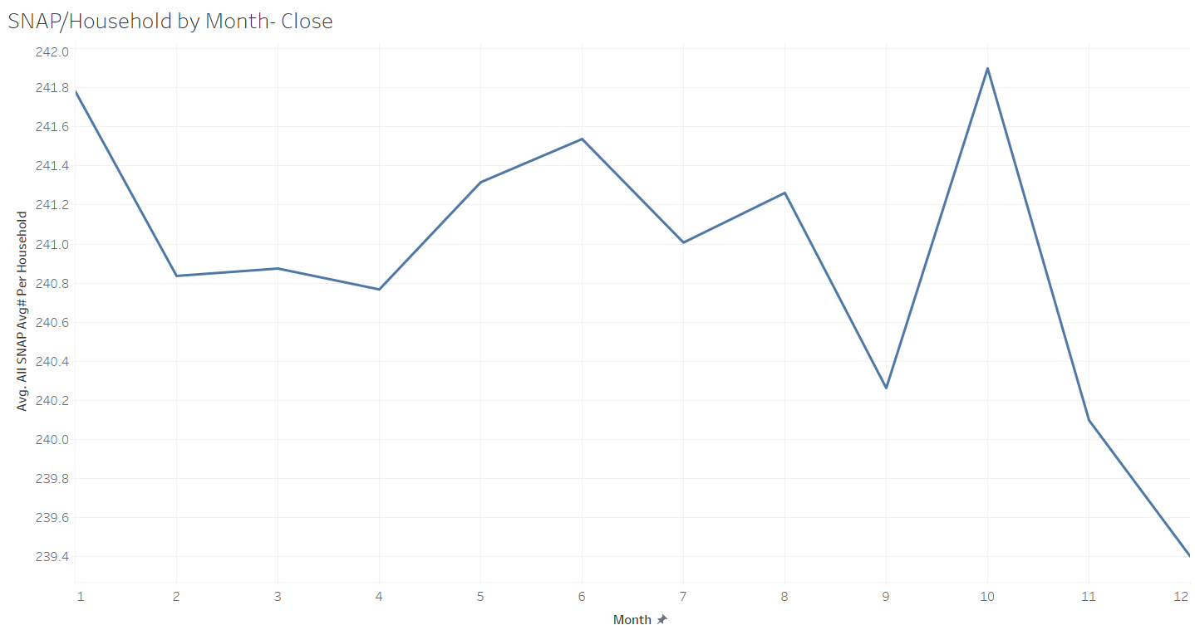
Analytics - SNAP by month
SNAP/household by month

Slide 10
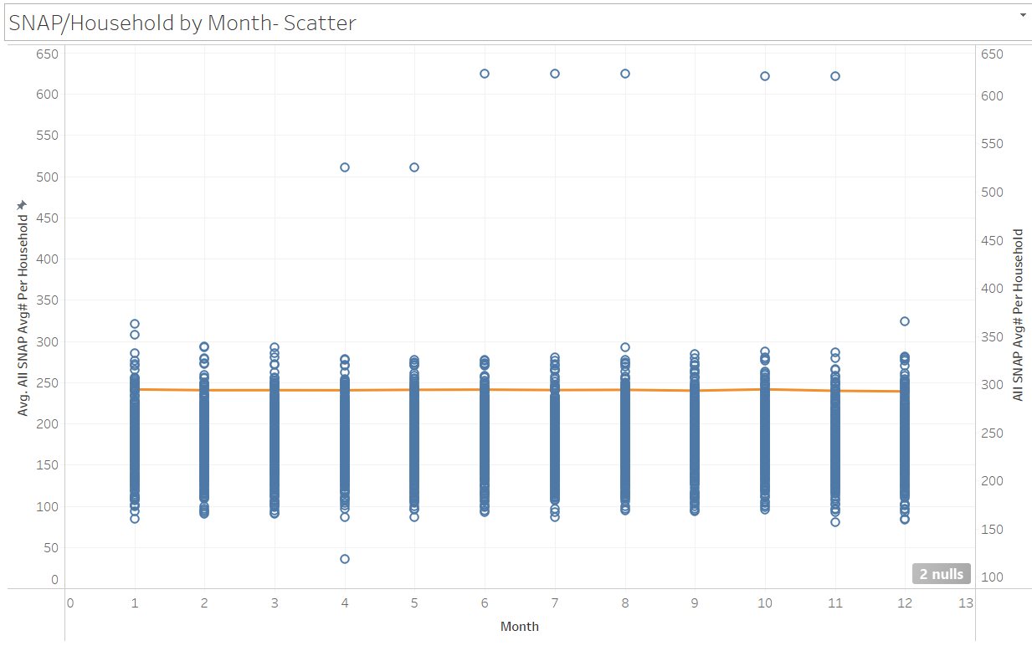
Analytics - SNAP by month, Continued
SNAP/household by month

Slide 11
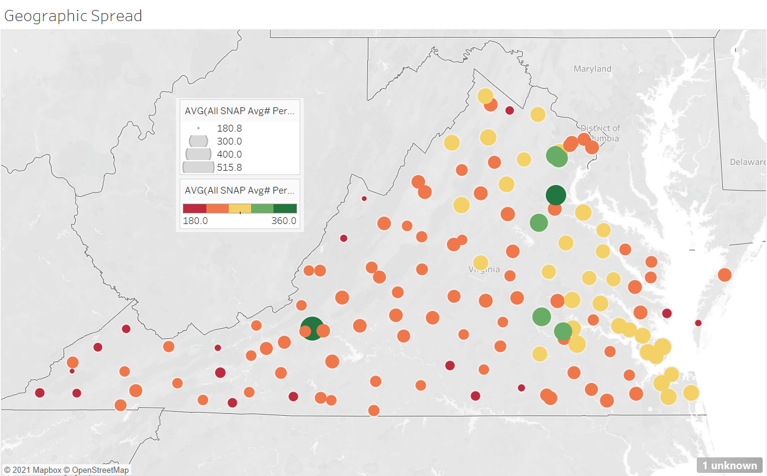
Analytics - Geographic Representation
Notes:
Screenshots from desktop application?
eli

Slide 12
Conclusion
Group experience
Troubleshooting
Issues with exporting time in initial step
Bigger insight into Tableau and communicating data
If done again, likely would take another path with the data
Proposed benefits
Clear depiction of government issued benefits in the state of Virginia
Could add even more background information to narrow down the exact demographic of users
Final comments
Exposure to how data cleansing and management works in the real world to come to appropriate conclusions
Interesting geographic conclusions in addition to household distribution of SNAP
Notes:
We ran into a lot of issues with the time to process the data and struggled to figure out what was going wrong.

Slide 13
Data Sources
https://www.dss.virginia.gov/geninfo/reports/financial_assistance/fs.cgi
https://fred.stlouisfed.org/release/tables?eid=268980&rid=175
https://www.census.gov/quickfacts/fact/table/richmondcityvirginia/INC110219

